Slide 1
Team:- Techgeek
SWETA LEENA
New Horizon College Of Engineering
Banglore
Date:- 24/05/2022

Slide 2
Problem Statement
Cyber crime has increased a lot now a days
Through call if you can recognize whether the user is valid or not
My project is voice bio metric which will recognize user by there username and password also through their voice

Slide 3




User Segment & Pain Points
Secured data via voice

Slide 4
Pre-Requisite
User should have account
Then user has to remember there user.id and password

Slide 5
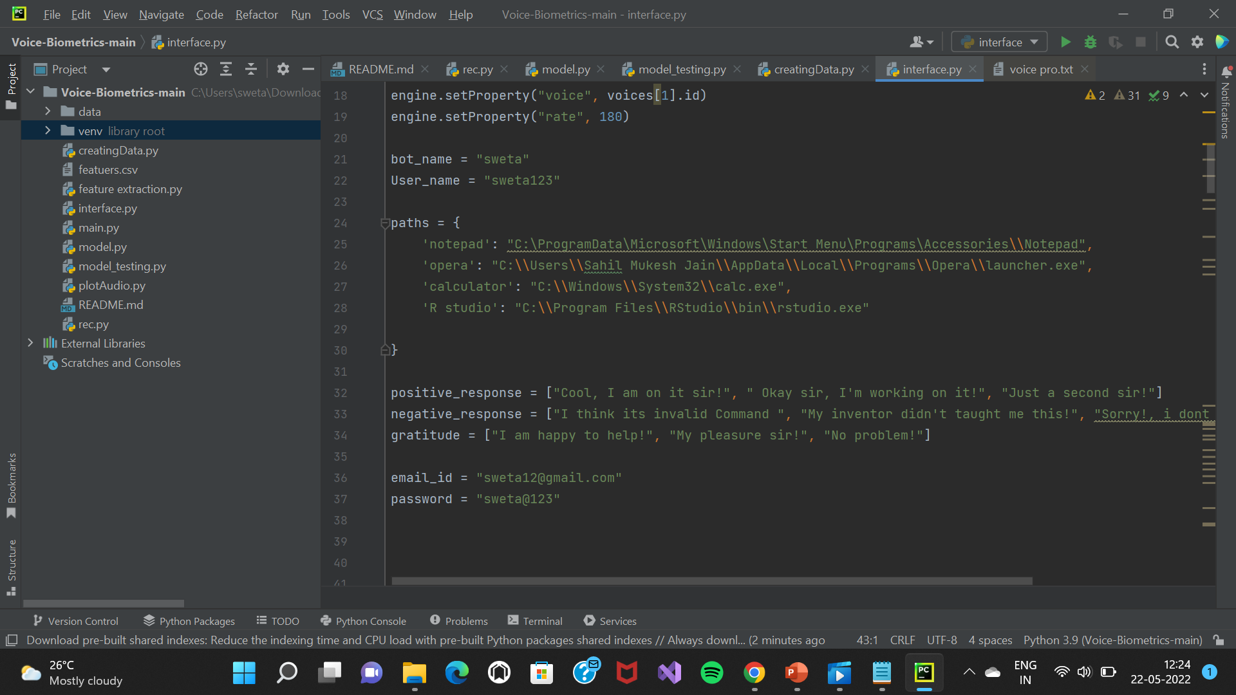
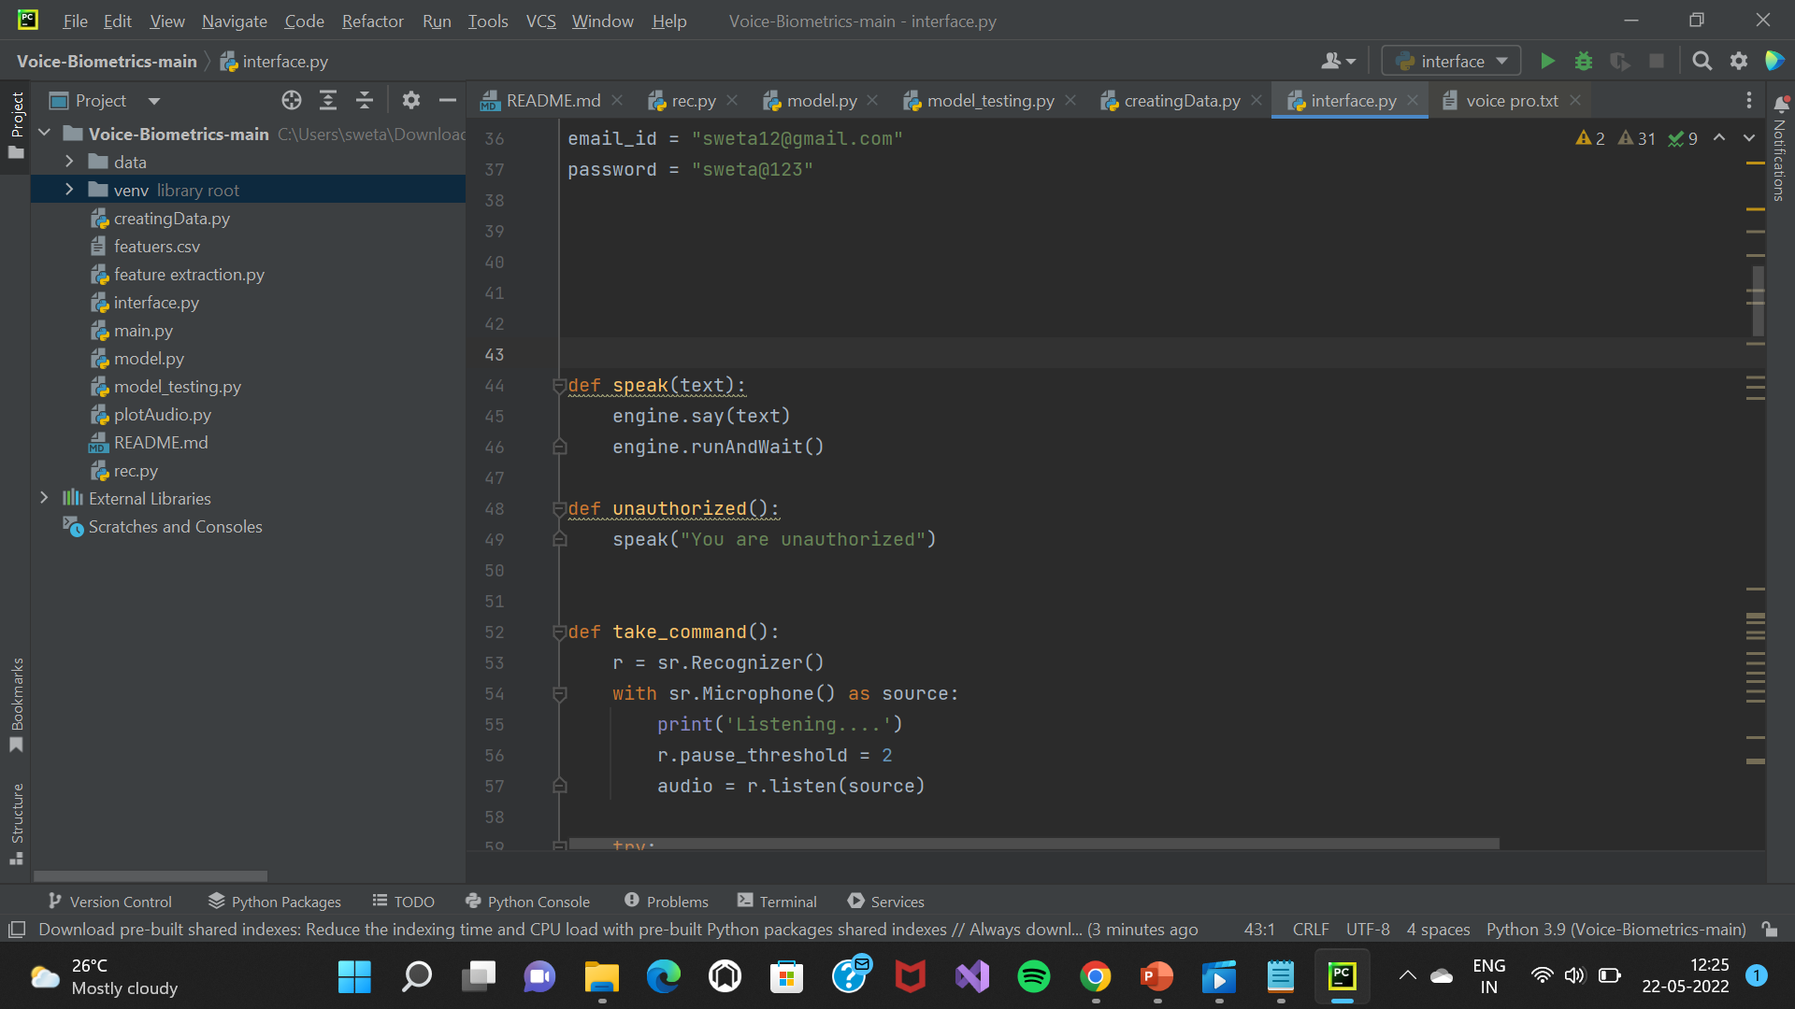
Any Supporting Functional Documents

Slide 6
Key Differentiators & Adoption Plan
Till now all voice biometrics supports all voices but this voice bio metric will support only one voice which user has given so that there will be no fraud in future.

Slide 7
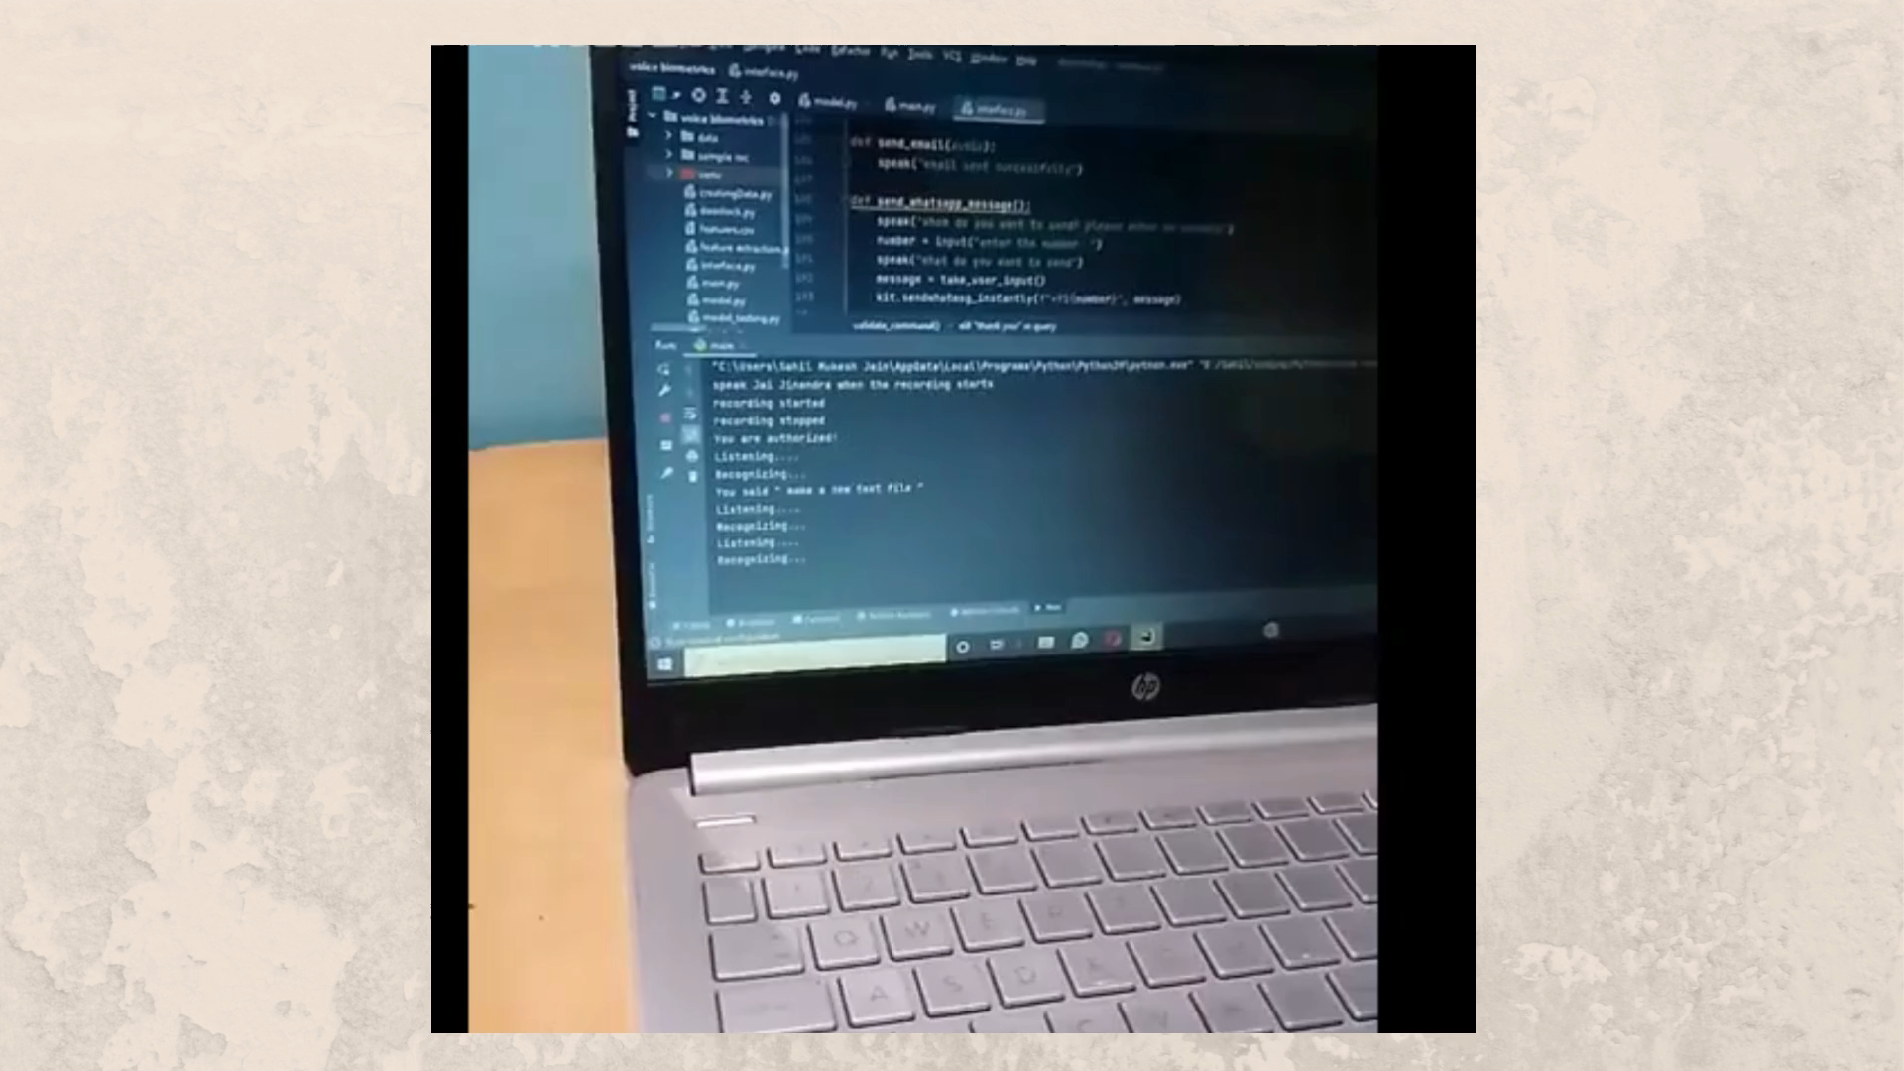
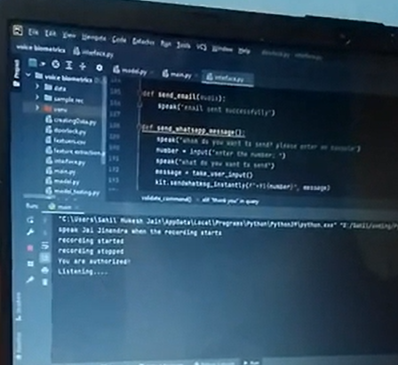
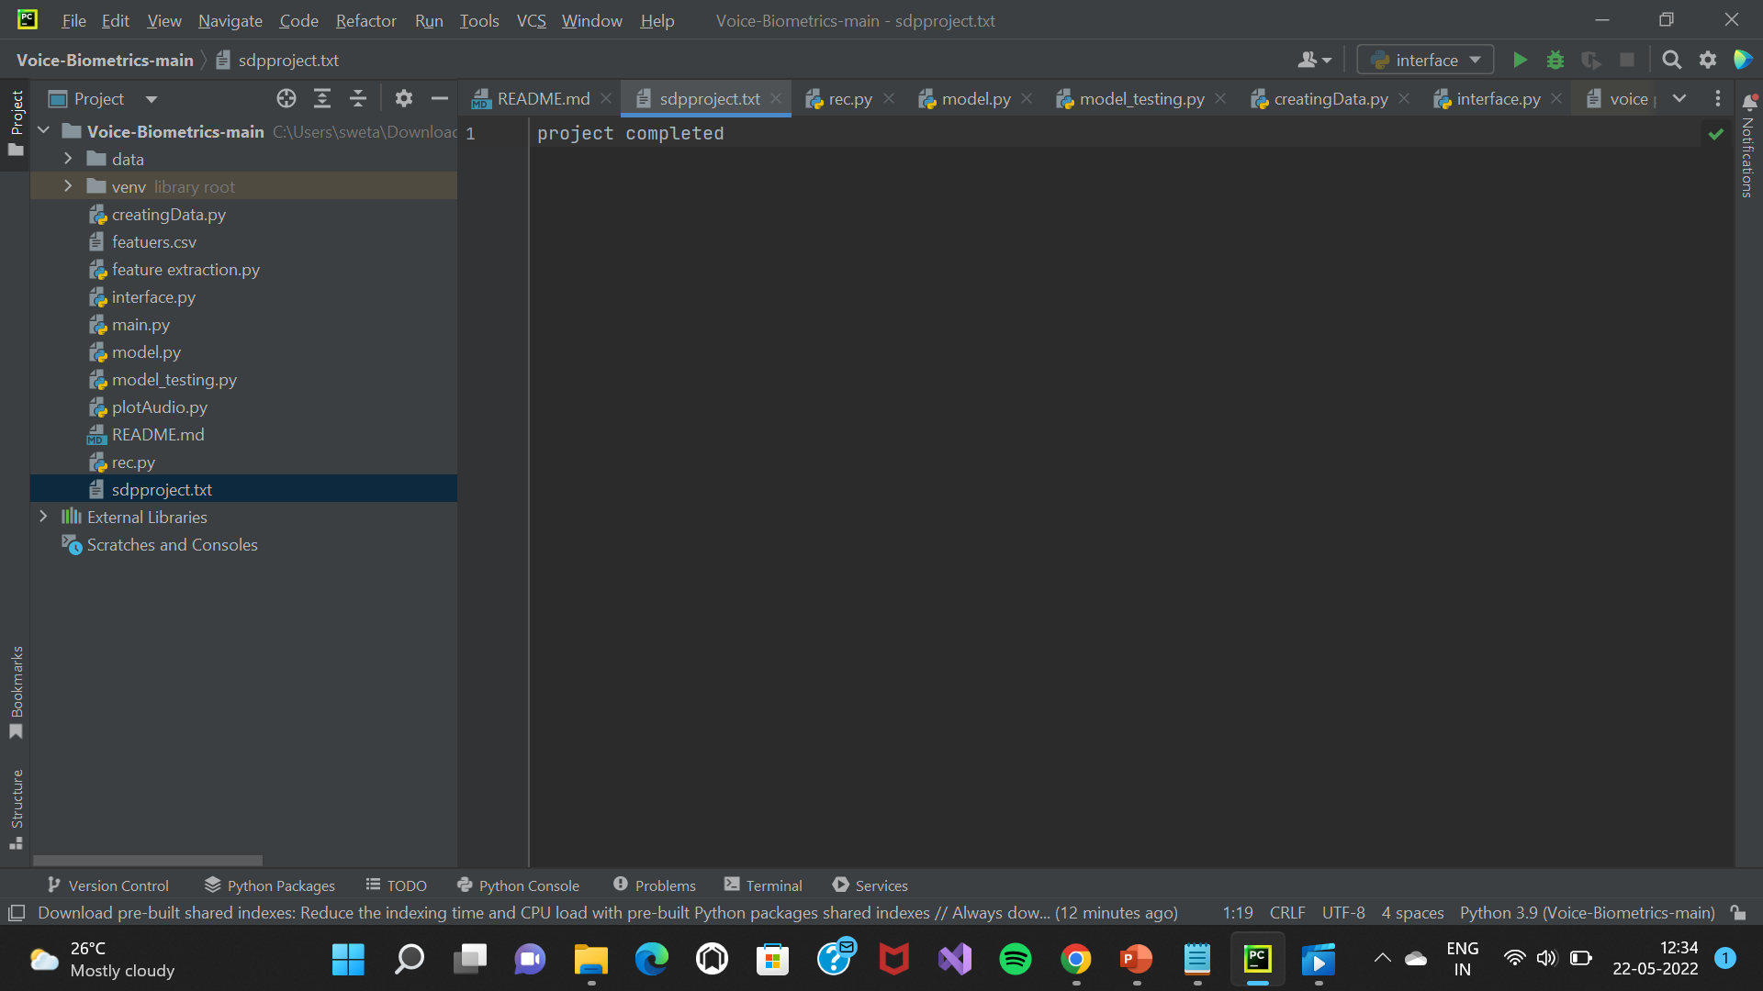
GitHub Repository Link & Demo Video/ Screenshot
Github link:-https://github.com/sweta9693/voice-biometric.git

Slide 8

Presentation

Slide 9
Thank You
Sweta Leena

